Slide 1
SMART GROCERY
BY: HRISHIKESH BADVE, SUDHANSHU BASUROY, UTSAV SHARMA, MRIDVIKA SURESH

Slide 2
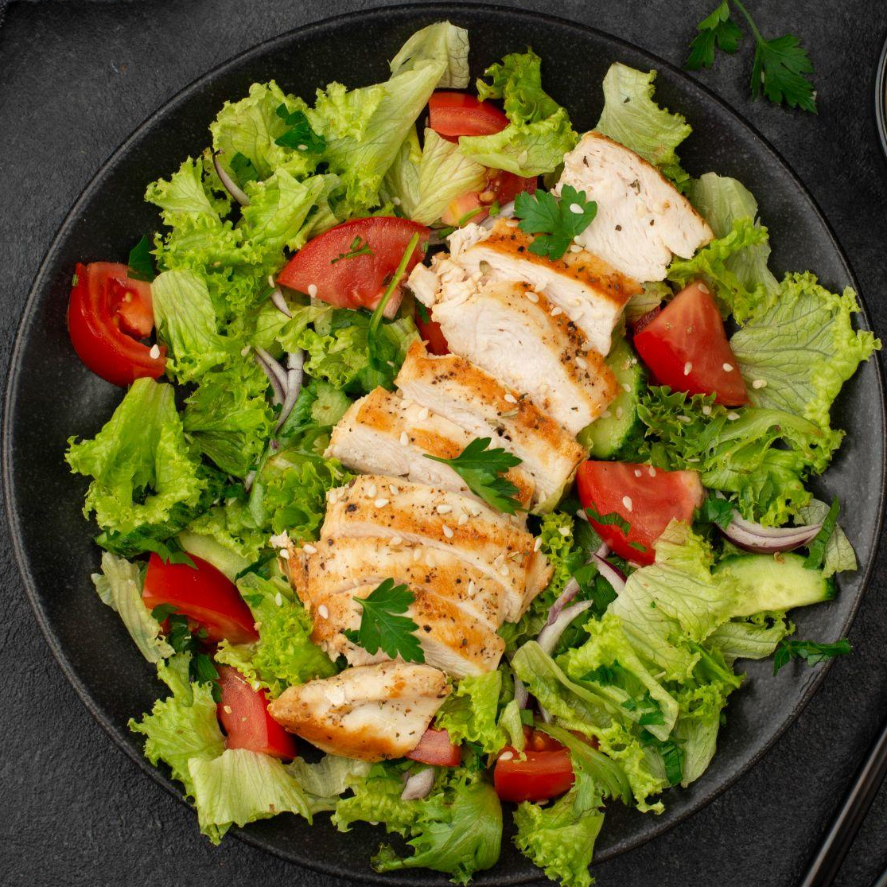
INTRODUCTION
Smart Grocery: Your Pocket Sous-Chef
This app helps users to quickly find recipes to match their ingredients, share their culinary creations, and streamline their shopping.
Our Goals
Target Users
Notes:
Goals:
To simplify meal planning and reduce food waste by utilizing available ingredients.
To foster a community of cooking enthusiasts who can share and discover recipes.
To enhance the cooking experience with easy-to-use tools that support a healthy lifestyle.
Target Users:
Home cooks looking for inspiration and wanting to make the most of their pantry.
Busy individuals who need quick, tailored recipe suggestions.
Eco-conscious users who aim to minimize food waste.
Culinary explorers eager to try new recipes and share their own.

Slide 3
PRIMARY FEATURES
Browse Recipes
Recipe Recommendations
1.
2.
3.
User Engagement
4.
Add Recipes
Users are allowed to browse through a list of recipes created by other users on the application
Application recommends recipes based on ingredients available in the user’s pantry
Allowing users to favorite recipes and rate each recipe
Users can create their own recipes and upload them

Slide 4
WHAT MAKES THIS SPECIAL
Explore Recipes (Web)
Search Stores Nearby
Shopping List
Access a wide array of recipes beyond those shared by users.
Users can search for grocery stores near them using Google Maps
Add ingredients to a shopping list based on requirements

Slide 5
DEMO

Slide 6






KEY PRACTICES AND TOOLS
Incremental Design
Firebase
Pair Programming
Edamam API
Kanban Boards
Postman
Notes:
Practices:
Incremental Design: Our project embraced incremental design, allowing us to refine and enhance our application iteratively
Pair Programming: By working in pairs, we combined expertise to tackle problems more efficiently and with greater creativity.
Kanban Boards: Kanban boards provided a clear overview of task status, enabling real-time tracking and adjustments for maximum productivity.
Tools:
Firebase: Backend
Edamam API: Food Recipe

Slide 7
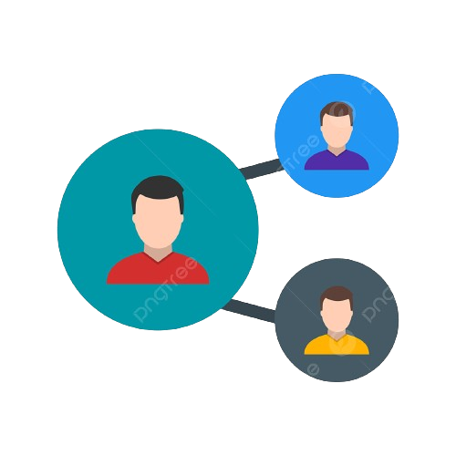
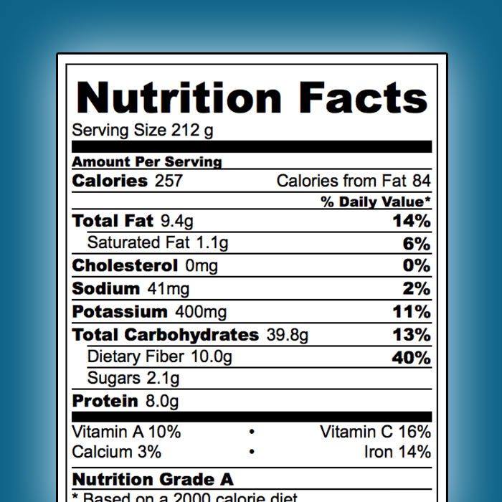



FUTURE FEATURES
Integration with Grocery Delivery apps
Share Recipes
Nutritional Information
Community Forums
API Collaboration
Notes:
Share Recipes
Collaborate with multiple APIs
Nutritional Content of Recipes
Community Forums
Tutorial Videos

Slide 8
THANK YOU!
ANY QUESTIONS?

